Slide 1
THE MICRONESIAN MILIEU
Myths and Facts
About Change Today

Slide 2
Myth #1
The Population Explosion
In Micronesia

Slide 3
Population in Micronesia

Slide 4
Palau Population

Slide 5
Micronesian Emigrants

Slide 6
Today there are about 40,000
Micronesians living abroad.
Nearly One out of every Five Micronesians is overseas.

Slide 7
Fertility Rate (Avg Births)
 | Palau | Marshalls | FSM
1973 | 6.6 | 8.4 | 8.3
1980 | 4.2 | 7.9 | 7.3
1989 | 3.1 | 7.2 | 5.6
1994 | 2.8 | 5.7 | 4.6

Slide 8
Myth #2
Expatriates are taking all the jobs from local people

Slide 9
Foreign Population
FSM 2,359 2% of pop
RMI 1,147 2% of pop
Palau 5,765 30% of pop

Slide 10
FSM Jobs: 1994-2000
Total Population
1994 jobs: 15,791
2000 jobs: 14,943
Job loss: 848
or 5%
Foreign Population
1994 jobs: 1,744
2000 jobs: 1,346
Job loss: 398
or 23%

Slide 11
Myth #3
The Brain Drain
In Micronesia

Slide 12
High School Diploma:
Percentage at home and abroad

Slide 13
College Degrees:
Percentage at home and abroad

Slide 14
Myth #4
The Economy Needs Only
A Strong Industry

Slide 15
FSM Economy
Total GDP $215 million
Government 42 %
Wholesale/Retail 22 %
Subsistence 16 %
Fishing, Tourism,
Agriculture 5 %

Slide 16
Gross Domestic Product
(Total and Per Capita for 1998)
FSM $216 m $2,045
RMI $102 m $1,623
Palau $160 m $8,806

Slide 17
FSM: Subsistence Economy
45 % of FSM people live off the land
They account for 15 % of entire economic output
They need a cash crop for spending money
Environmental pressure as a result

Slide 18
Myth #5
Education Is the Sure Path to a Good Job

Slide 19
Employment in FSM & RMI

Slide 20
Facts on Education
School enrollments peaked in 1990s
Standards are still low in comparison with Guam, CNMI, and Hawaii
Dropout Rates are still high:
1 of 2 graduate in Palau
1 of 3 in Yap
1 of 4 in Pohnpei and RMI
1 of 6 in Chuuk

Slide 21
High School Graduates
1500 graduates a year (FSM, RMI, ROP)
100-200 new jobs a year open, most of them in Palau
2500-3000 yearly leave Micronesia to live abroad

Slide 22
The Truth of the Matter
Most high school graduates find jobs overseas
The jobs are unskilled, entry-level
Education is important for their job advancement—and also for those who choose to remain at home.

Slide 23
Myth #6
The Loss of Catholics to the Small Sects

Slide 24
Catholic Church Membership
(Percentage in 1973 and 2000)

Slide 25
Protestant Church Membership (1973-2000)
1973 2000
FSM 47% 40%
RMI 90% 55%
Palau 25% 23%

Slide 26
Other Churches
(in FSM between 1994 and 2000)
Baptist and Mormons decreased a bit
SDA increased by a couple of hundred members
Assemblies of God grew by nearly 1300 members

Slide 27
Myth #7
Family Breakup is More Common Today than Ever Before

Slide 28
Changes in Marriage
The transition from arranged marriage to individual choice of spouse began before the war.
By the late 1940s most young people were choosing their own spouses.

Slide 29
Divorce Rates
Breakup common in post-war years
Average of 2-4 marriages in Yap Outer Islands and Majuro. Perhaps more in Palau and Yap
Long settling down period for young people

Slide 30
Divorce Rate: Chuuk and US
Informal sample in Chuuk: one of seven marriages break up
Figures in US: nearly one out of two marriages break up

Slide 31
IMPORTANT CHANGES TODAY
FAMILY
LAND
CONFLICTS
CUSTOM
INDIVIDUALISM

Slide 32
THE CHANGING FAMILY

Slide 33
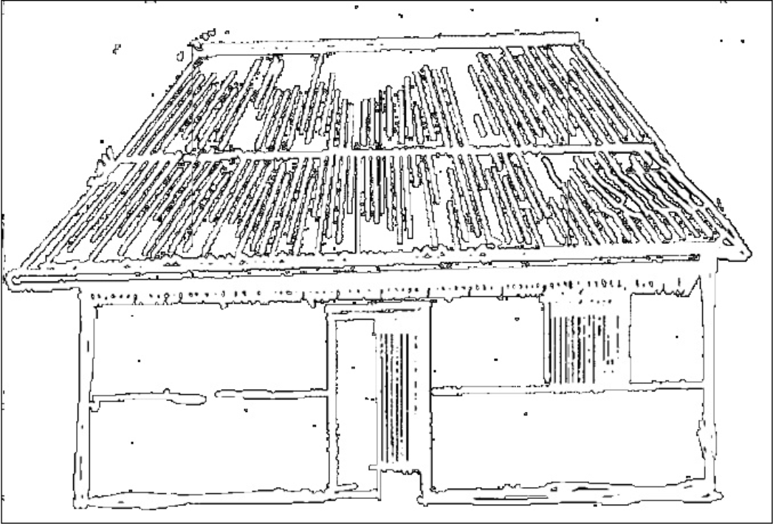

In a traditional society…
1.Kin worked land together
3. Cooked & ate together
2. lived together

Slide 34
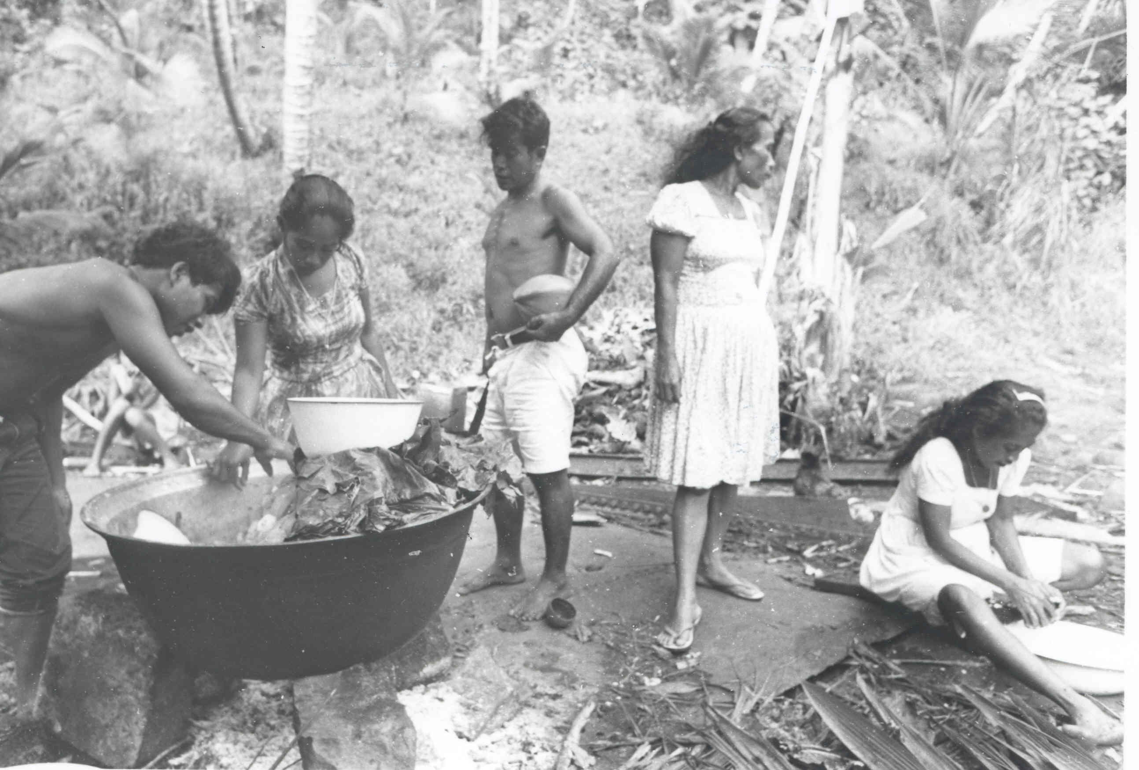
The lineage works as a unit.

Slide 35
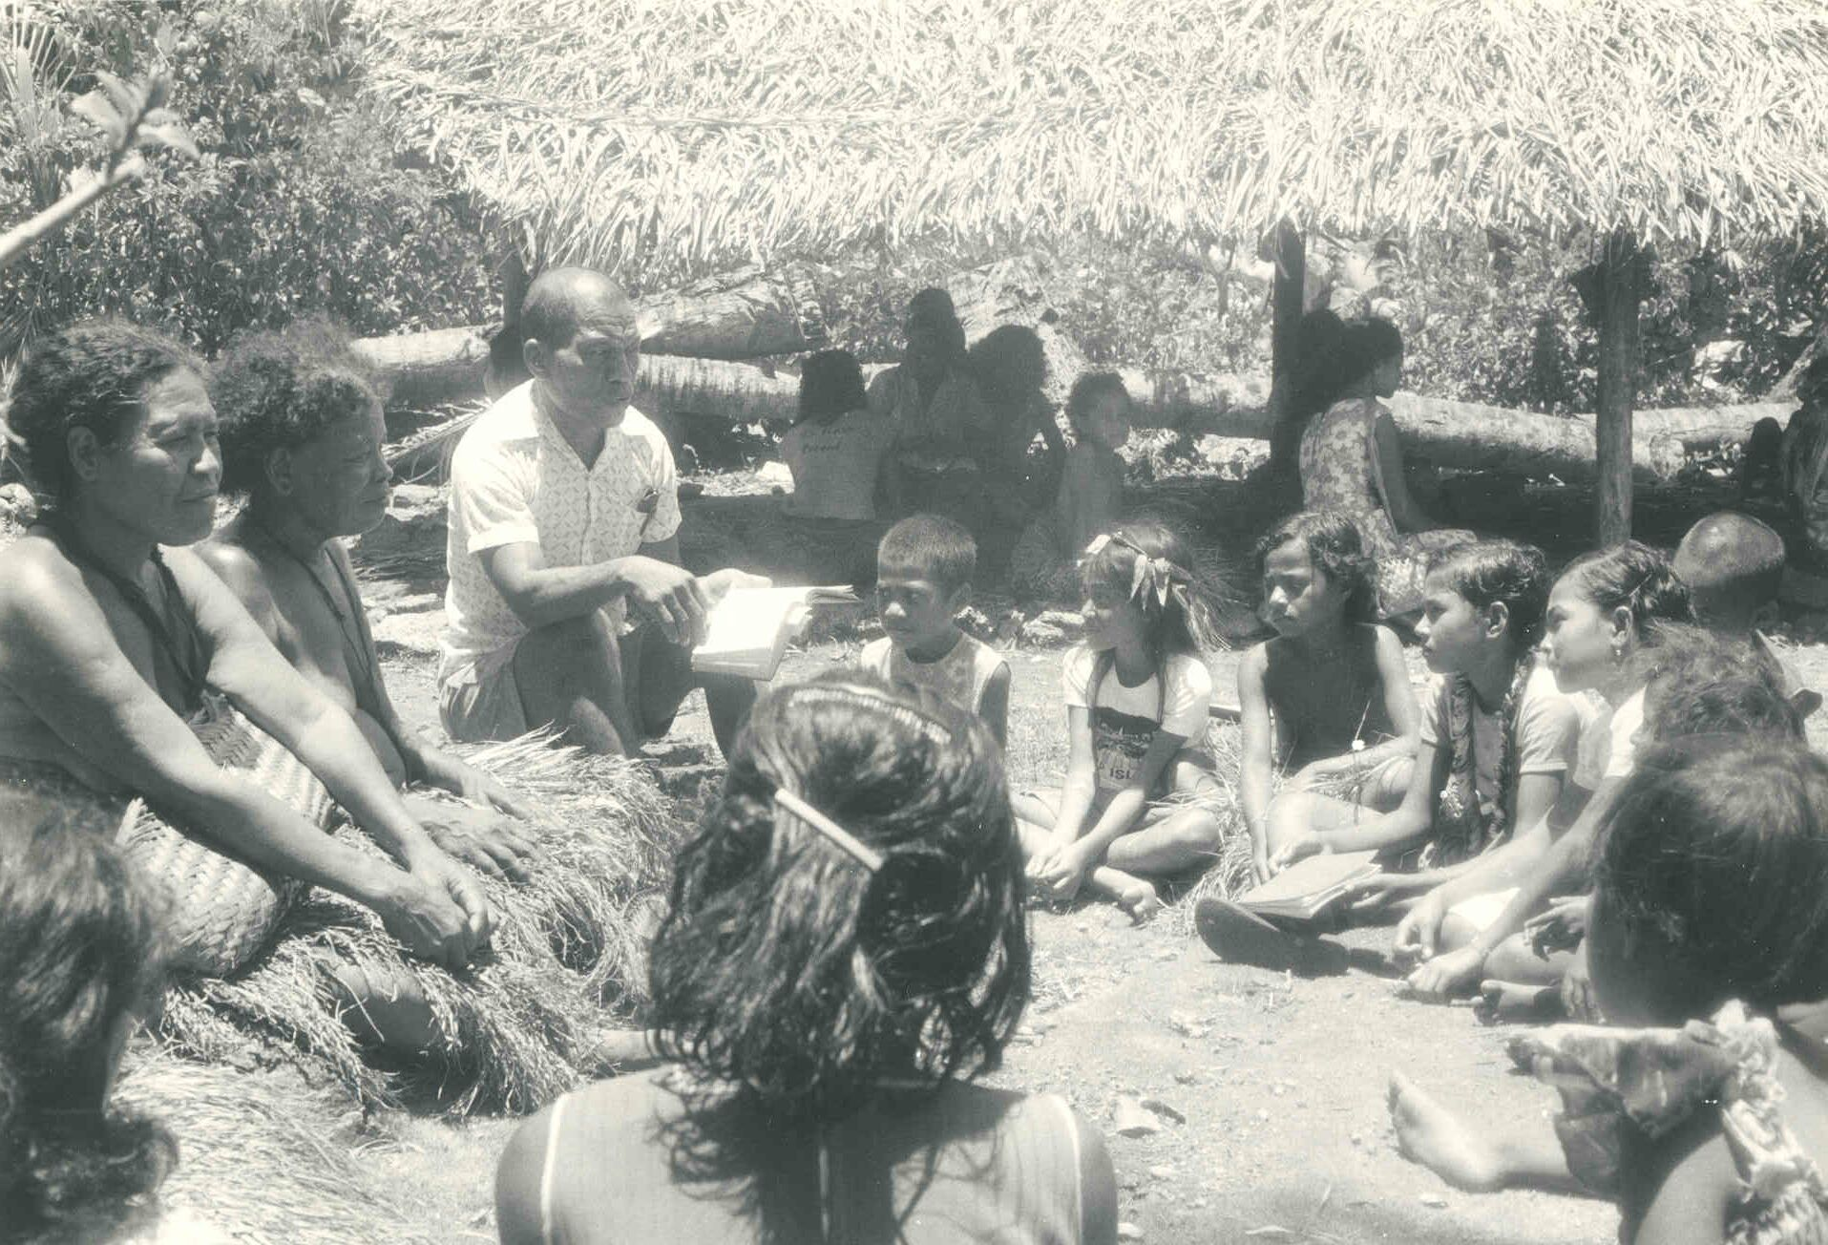
All lineage members share in parenting.

Slide 36
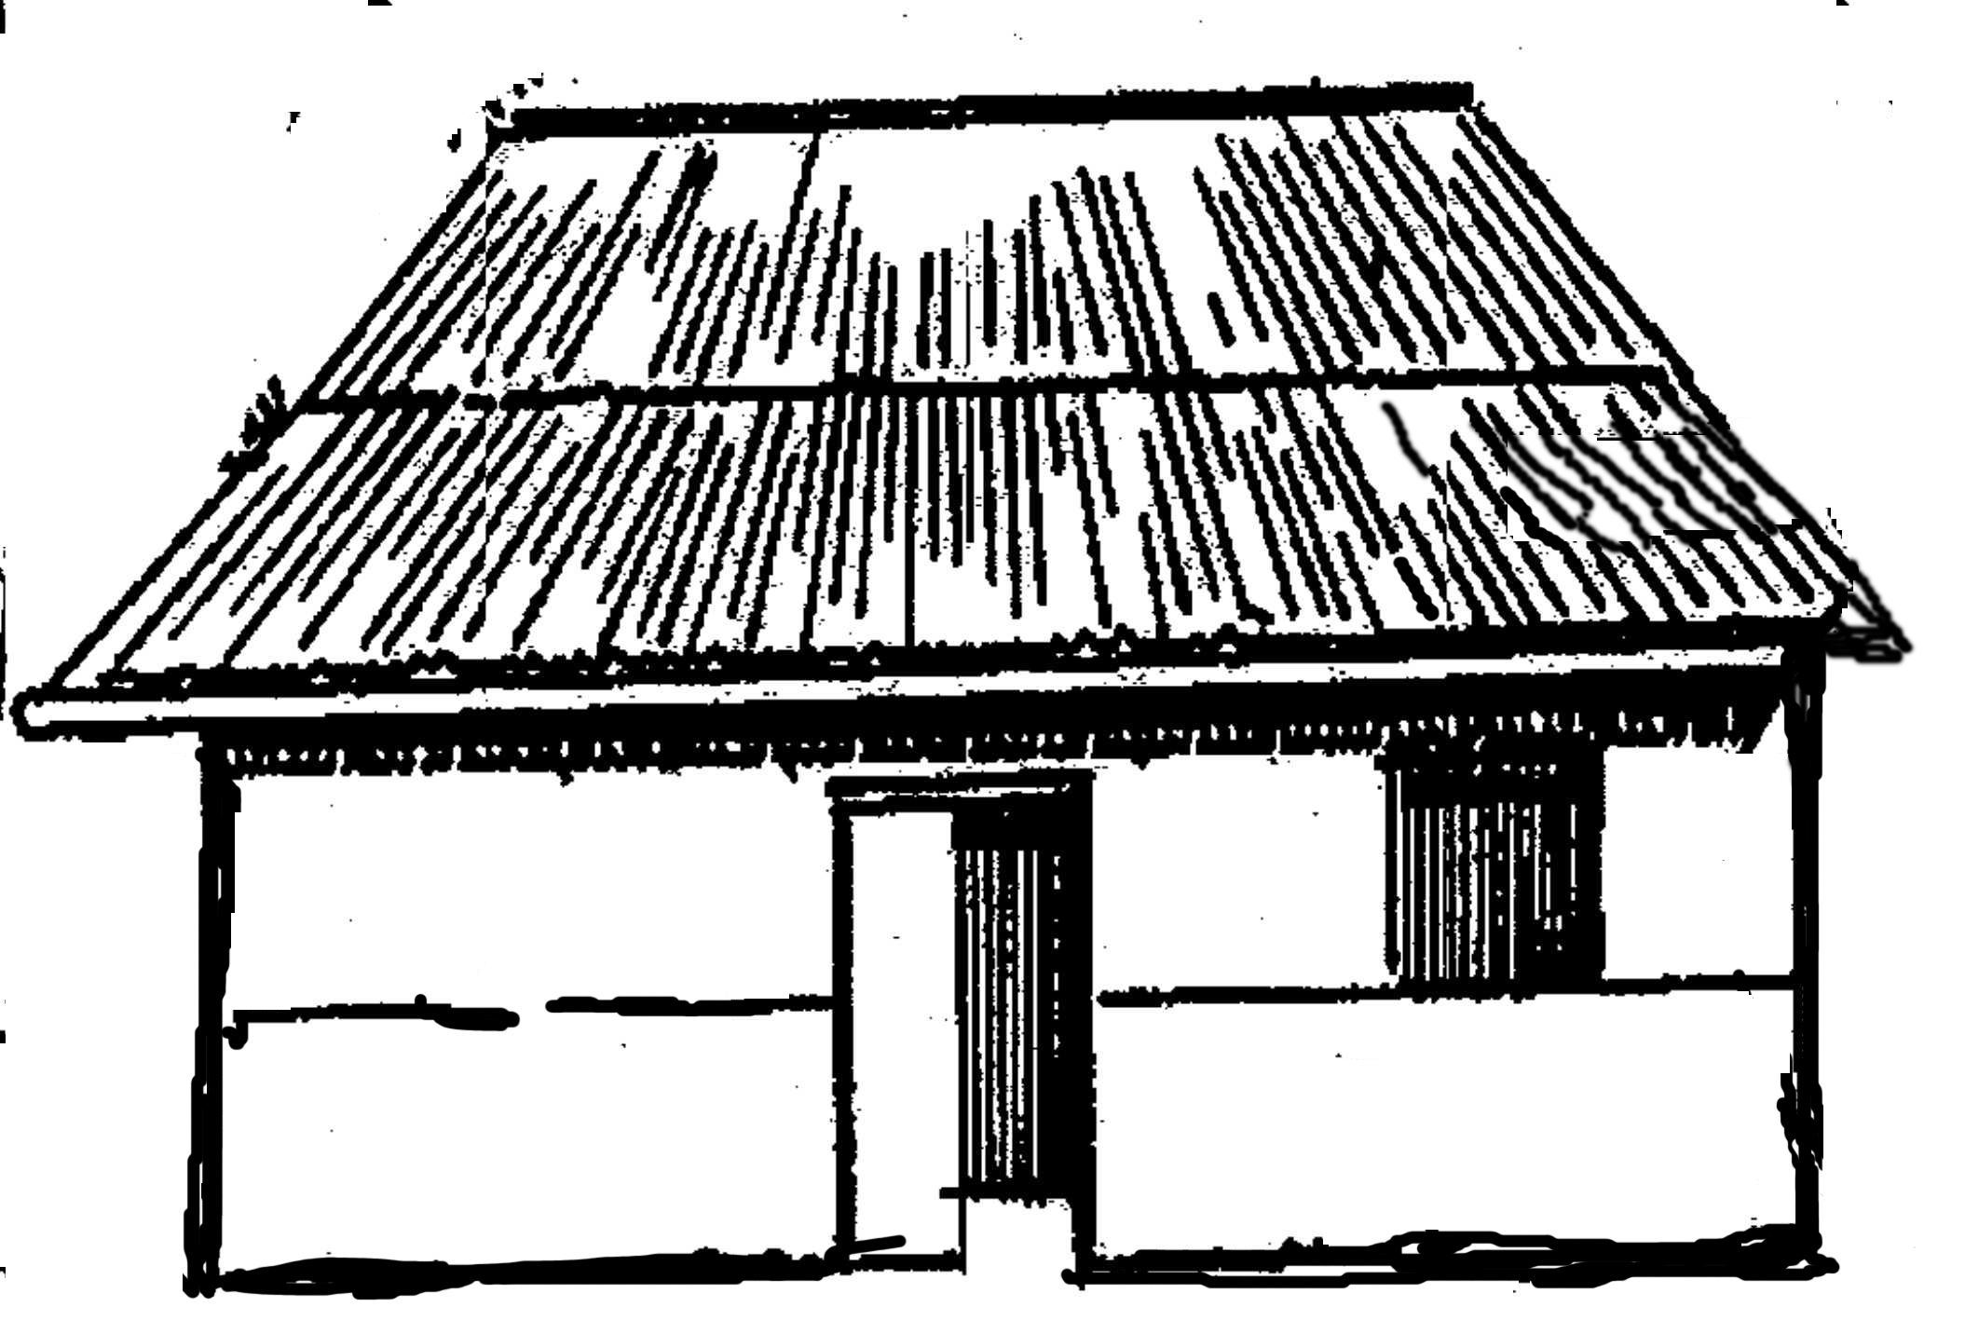
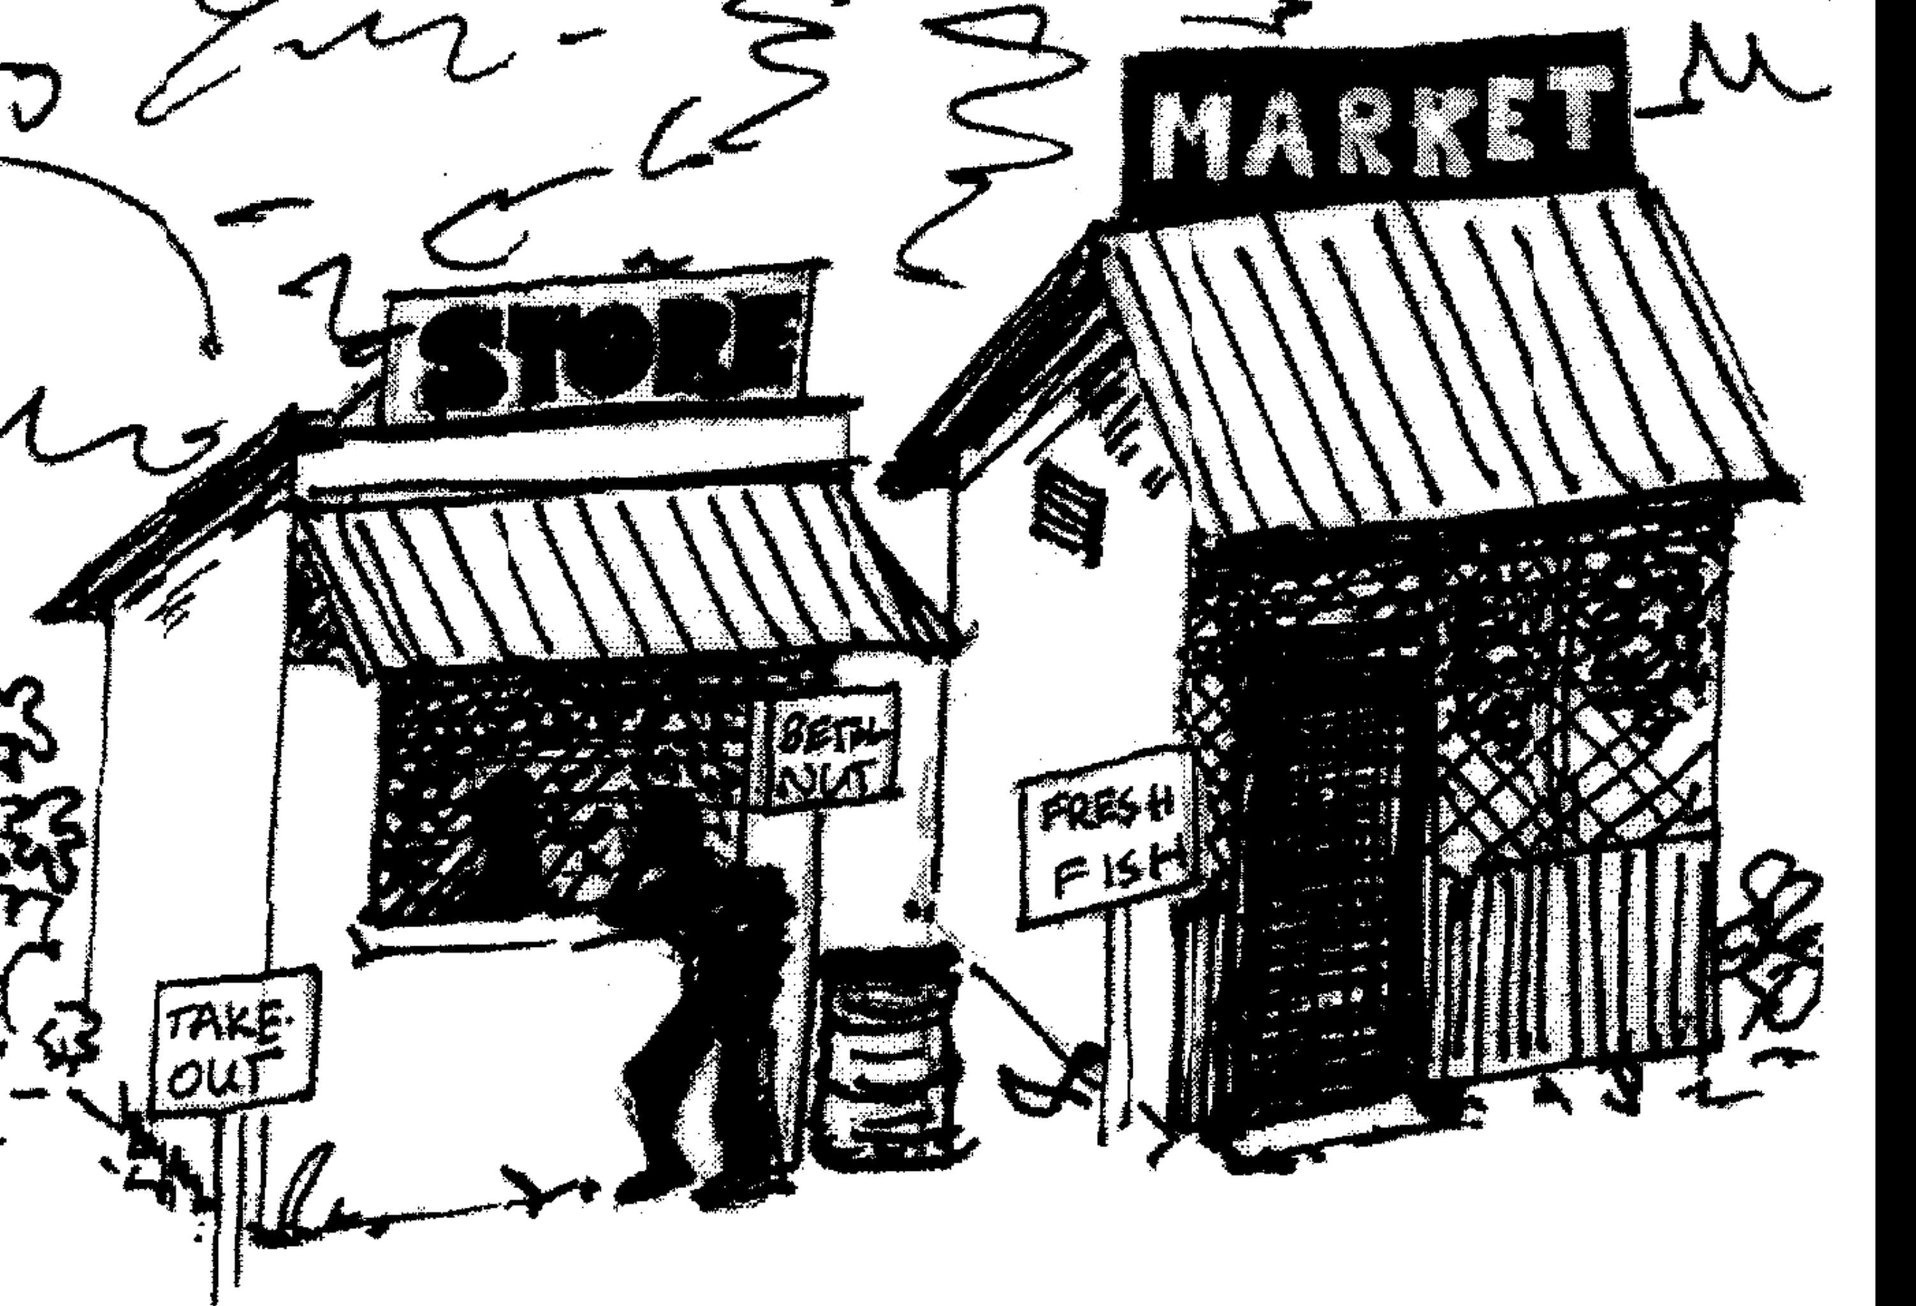
In the cash economy
More people get jobs…
and now have the ability to support themselves...
not from land but from the food they buy
Canned mackerel
rice
rice
Canned mackerel
Canned mackerel
rice

Slide 37
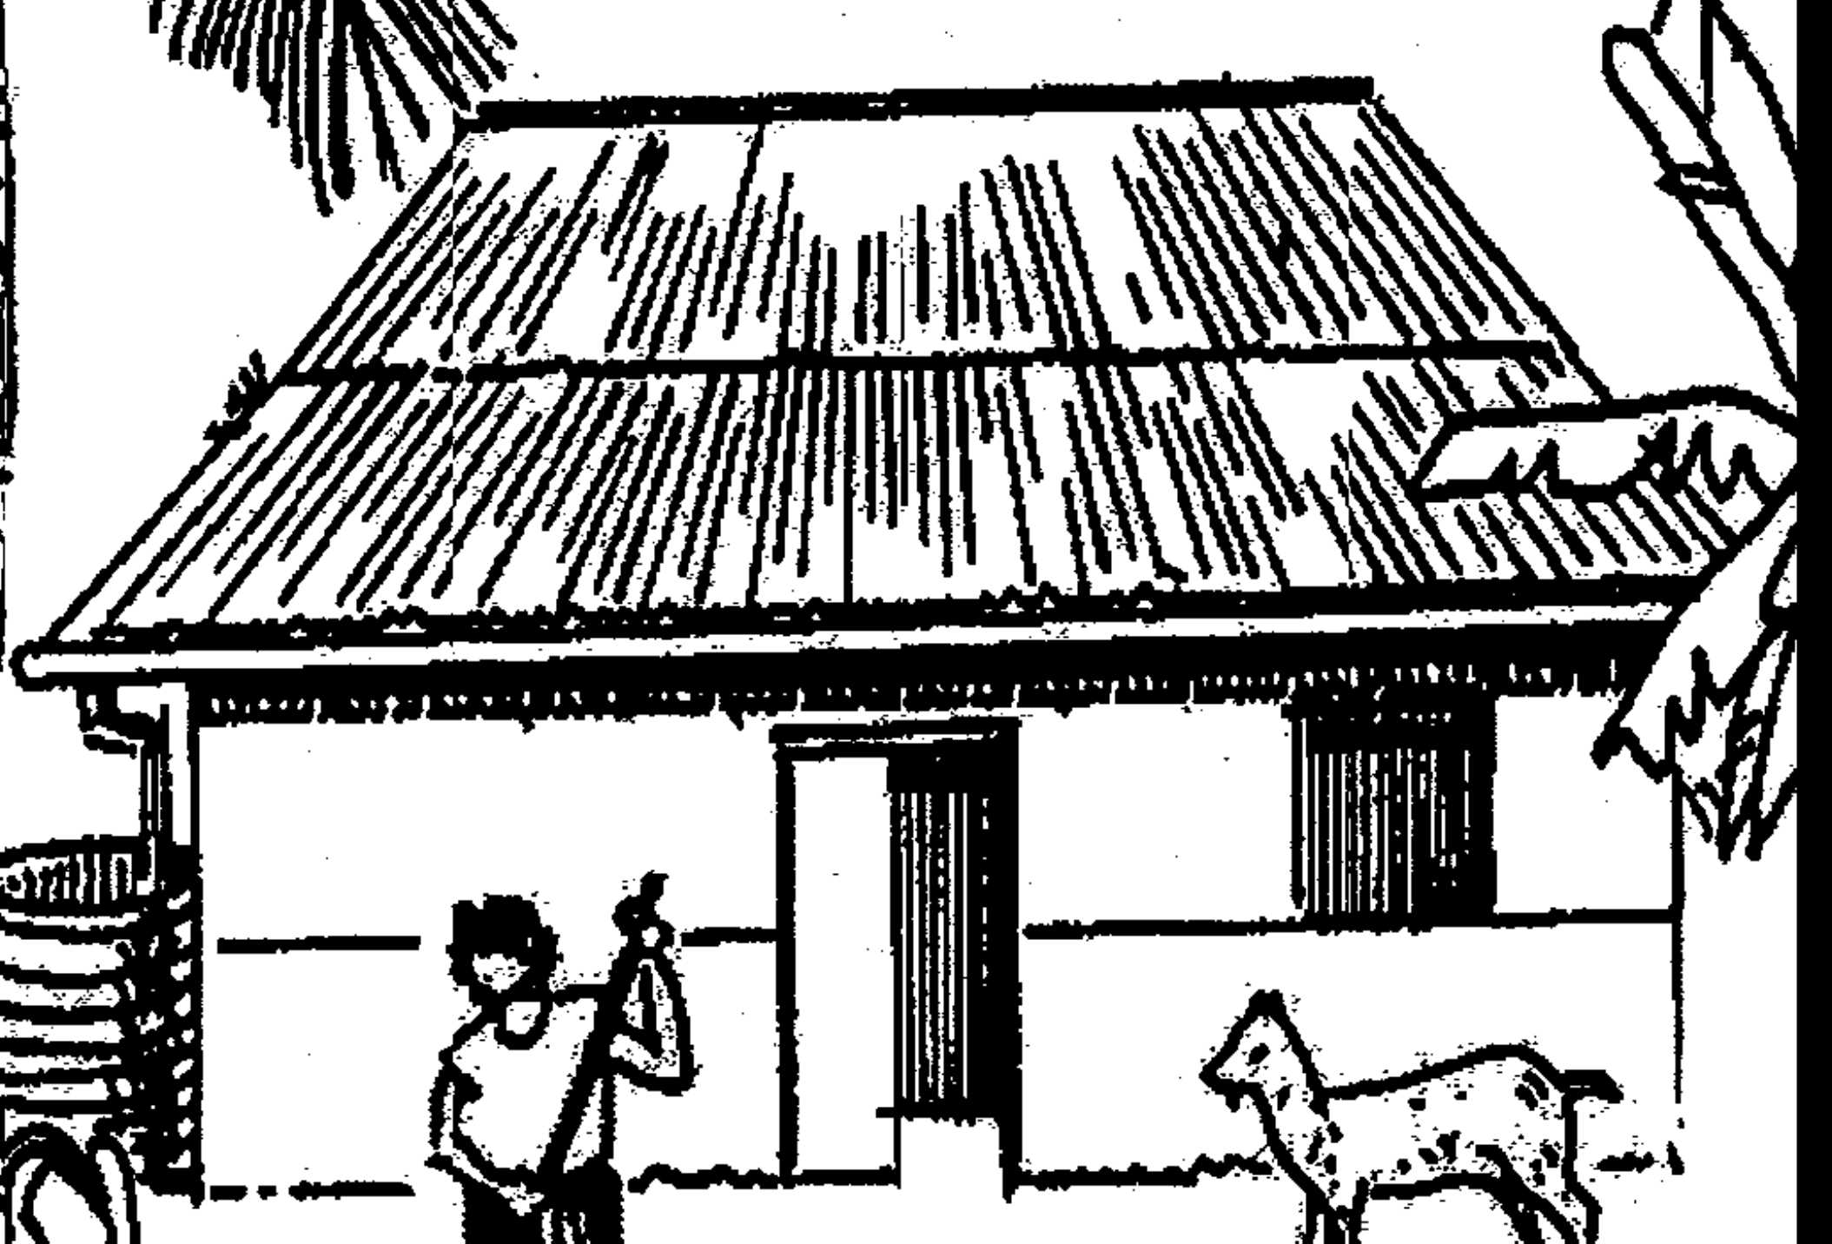

Cracks in the lineage.

Slide 38
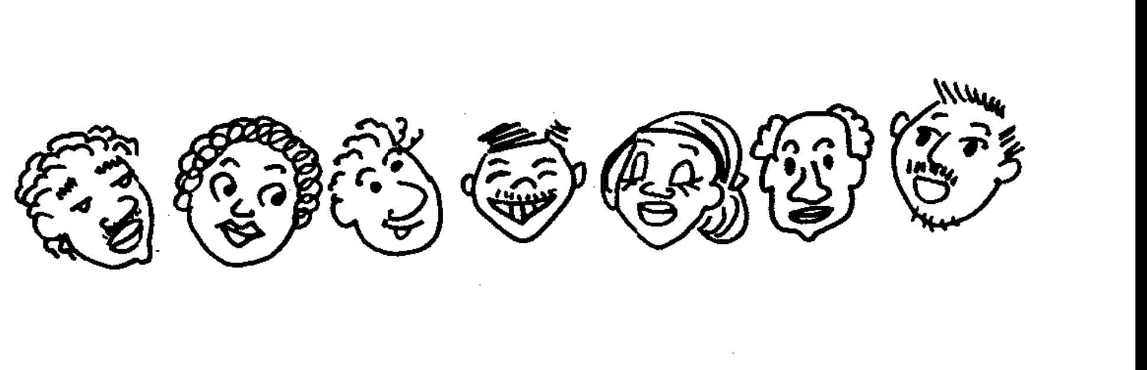
Childrearing now concentrated on mother & father

Slide 39
. . . and the safety net
of the united village
Is gone.

Slide 40
•
•
But the smaller family must also provide its own resources…
… and so parents spend more
time away from home earning
cash.

Slide 41
Disputes within the family are not settled as easily as in the past
In the past….
Today…..
x
Lineage head
Settled disputes
dispute
dispute
For example, between brothers

Slide 42
Authority gap
grows
Between father & son

Slide 43
The effect of the growing gap between father and son…
And the shortage of older relatives to intervene in family conflicts…
Is sometimes SUICIDE

Slide 44
Another Effect:
MORE WIFE BEATING
X
X
X
The brothers don’t help
They no longer have the same responsibility for their married sisters.

Slide 45
Women’s workload increases
Less help from her husband, if he works away from home
Less help from her extended family

Slide 46
CHANGING LAND PRACTICES

Slide 47
Traditional Society:
people had mystical ties with their land
Symbolized by:
burial of umbilical cord at birth
And burial of body at death

Slide 48
Today, land is bought & sold for cash

Slide 49
Land ownership shifts
From corporate To individual

Slide 50
Land inheritance patterns change
From LINEAGE
To
FATHER-SON

Slide 51
This means conflict in the family
Inheritance patterns change
Disputes arise within families
Lineage heads who once settled such disputes are now powerless

Slide 52
CONFLICT RESOLUTION

Slide 53
Disputes within the family are not settled as easily as in the past
In the past….
Today…..
x
Lineage head
Settled disputes
dispute
dispute
For example, between brothers

Slide 54
In community disputes
People used to rely on traditional chiefs
and other authorities to settle disputes.
But today chiefs are more rarely consulted for help

Slide 55
TRADITIONAL CHIEFS
Now without the old power because
MONEY REPLACES LAND
As the dominant resource

Slide 56
CUSTOMARY EXCHANGES

Slide 57
Customary Exchanges include:
Funerals
Weddings
First Birthday Celebrations
House-Building – Ocheraol in Palau

Slide 58
Basic Functions of Exchanges:
Meet material or social need—eg, putting up a house, or burying a relative
Solidify community in giving support to some of its members
Advance the prestige of the family sponsoring the event

Slide 59
But today these customary events
Are much larger, with more participants
Are more frequent (in view of modern transportation and communication)
Require cash rather than produce of land and sea
They are more frequent
and more expensive.

Slide 60
So, today’s exchanges cost a lot, putting a financial burden on families
While the customary events…
lose some of their original purpose
(eg, family forgiveness at funerals)
and do not have the reciprocity they once had
(eg, contributions from both sides)

Slide 61
INDIVIDUALISM

Slide 62
Individualism in finances
Heads of households and individuals manage their own money

Slide 63
Sharing is still important
But control of money is with the heads of households

Slide 64
Individualism in finances brings choices
Choice of a spouse
Choice of a career
Choice of a lifestyle

Slide 65
SUMMARY
As $$ replaces Land as main resource:
Extended family is fragmented
greater authority of father
less help in raising kids
elders not present to settle disputes

Slide 66
Land practices change…
Land inheritance changes, passing from father to son
Land owned by individuals rather than kin groups
Women lose control of land

Slide 67
Authority system changes
Chiefs lose old authority, which was based on importance of land
Lineage heads no longer exercise much authority
Dispute resolution more difficult

Slide 68
Jobs become important
Search for jobs leads people to leave family land
When jobs cannot be found at home, people migrate abroad
Cash salary weakens reliance on group and leads to individualism

Slide 69

MICRONESIAN SEMINAR

